Slide 1
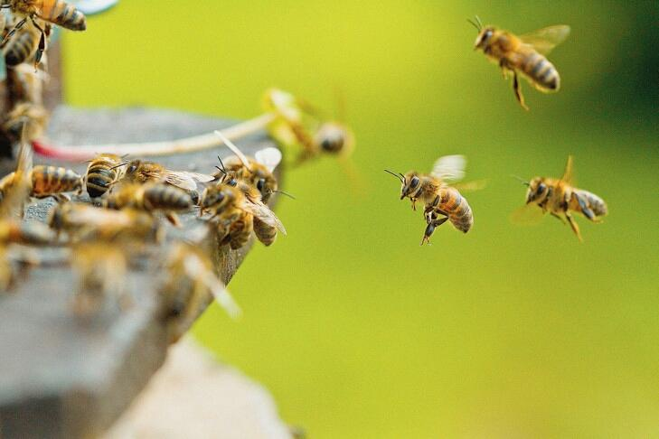
Probiotics in beekeeping ApiBioFarma (ABF) from Probiotics Polska

Slide 2
For what ? - hygienizes frames - improves colony’s health - improves bee’s health - bio disinfection of the hive

Slide 3
When ? - at the beginning of the season : spring -during summer and the end of summer

Slide 4
How ? - hygiene of the colonies : spray 100 ml ABF/5l water on frames (for 20 hives) - in the water for the bees: 10 ml ABF for 1,5 l water -in the feeding syrup before winter 100 to 150 ml ABF / hive (1l ABF for 10 hives)

Slide 5
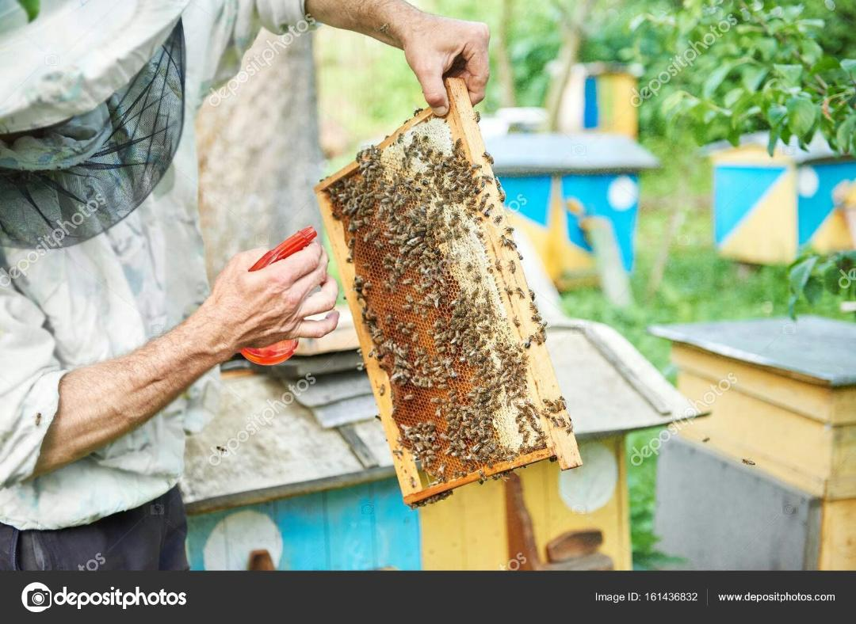
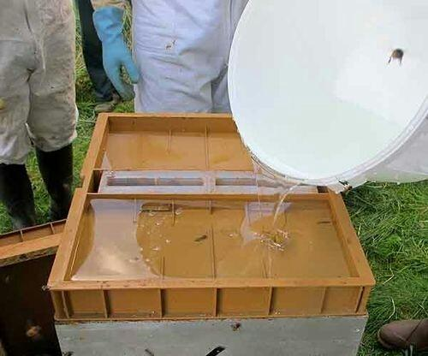

Slide 6
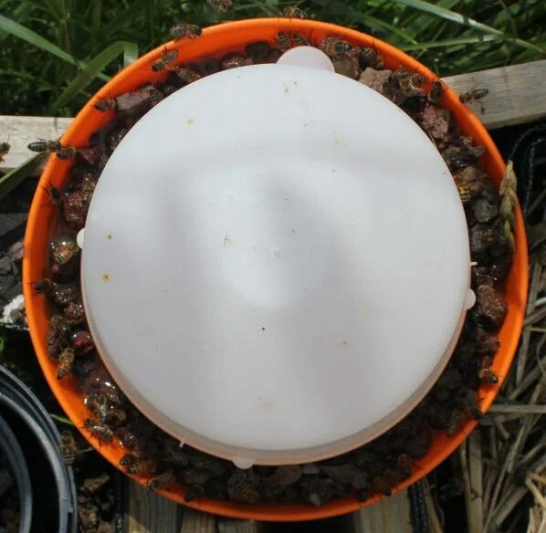
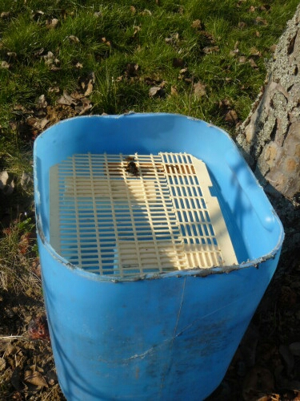

Slide 7
Observed results - colonies are more dynamics - wax construction of the frames is accelerated -no weak colonies in the season and after winter -no loss of colonies during winter and after winter

Slide 8
Thank you for the welcoming by the enterprises Thank you for your attention The Belgian Team

